Slide 1
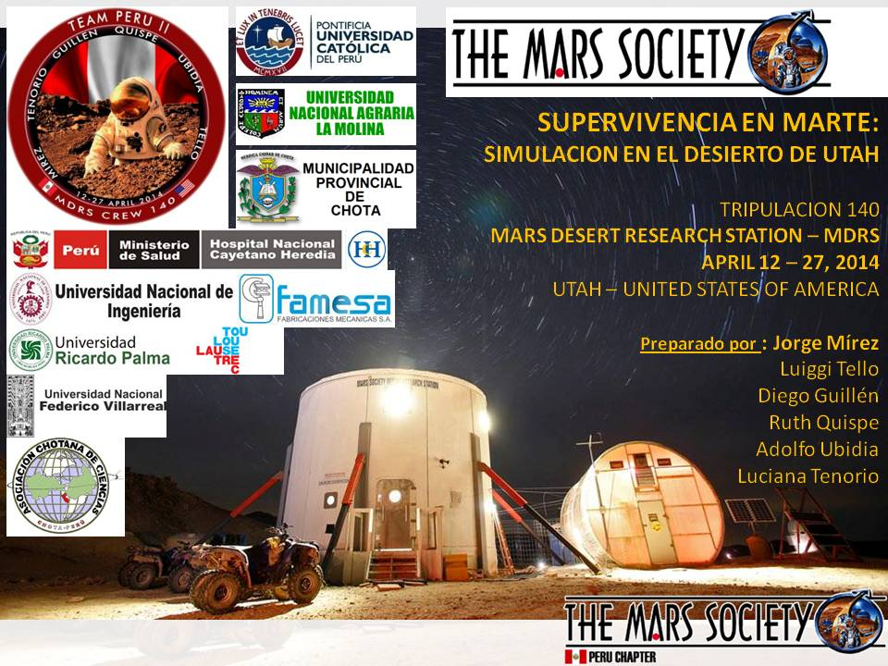
Jorge Mírez in Crew 140 - Crew 141. April 12 - May 10, 2014
Mars Desert Research Station – MDRS, Utah - USA

Slide 2
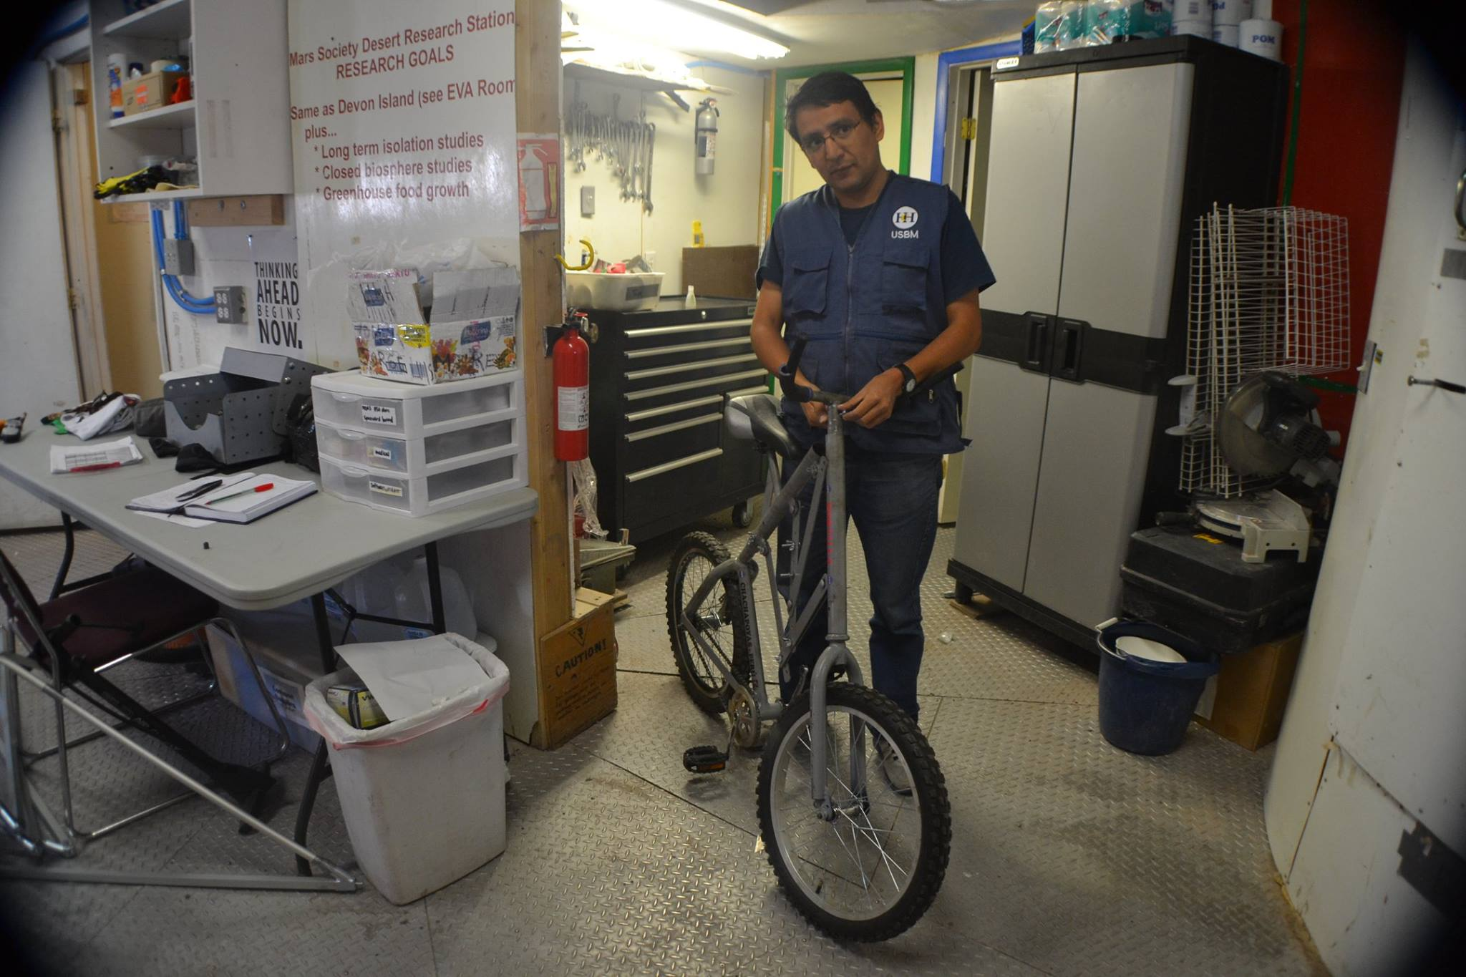
Jorge Mírez in Crew 140 - Crew 141. April 12 - May 10, 2014
Mars Desert Research Station – MDRS, Utah - USA

Slide 3
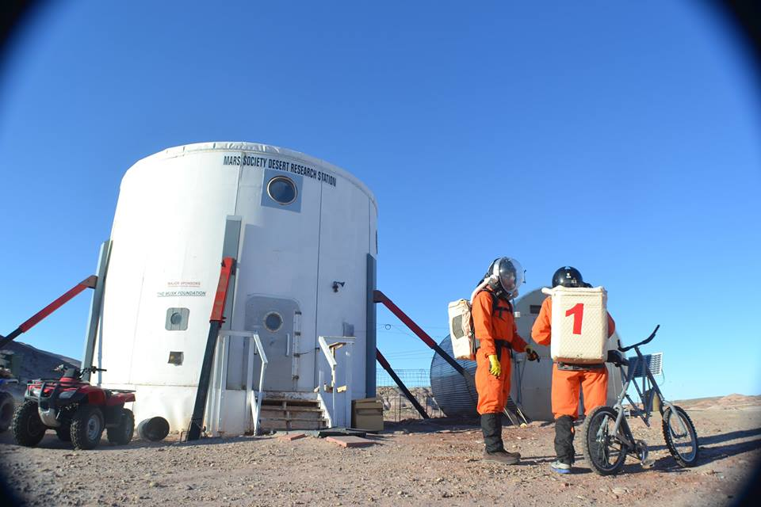
Jorge Mírez in Crew 140 - Crew 141. April 12 - May 10, 2014
Mars Desert Research Station – MDRS, Utah - USA

Slide 4
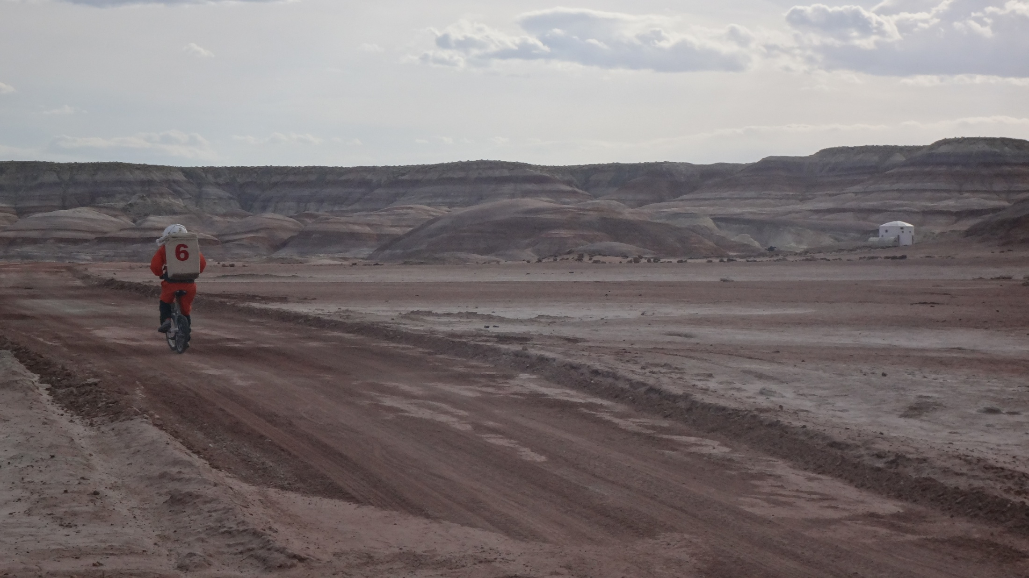
Jorge Mírez in Crew 140 - Crew 141. April 12 - May 10, 2014
Mars Desert Research Station – MDRS, Utah - USA
Bicycle/stretcher “MPC-1”

Slide 5
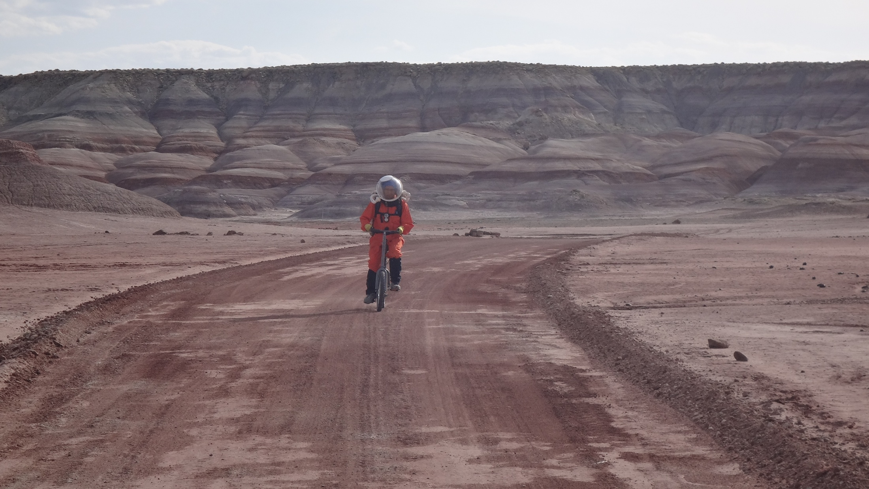
Jorge Mírez in Crew 140 - Crew 141. April 12 - May 10, 2014
Mars Desert Research Station – MDRS, Utah - USA
Bicycle/stretcher “MPC-1”

Slide 6
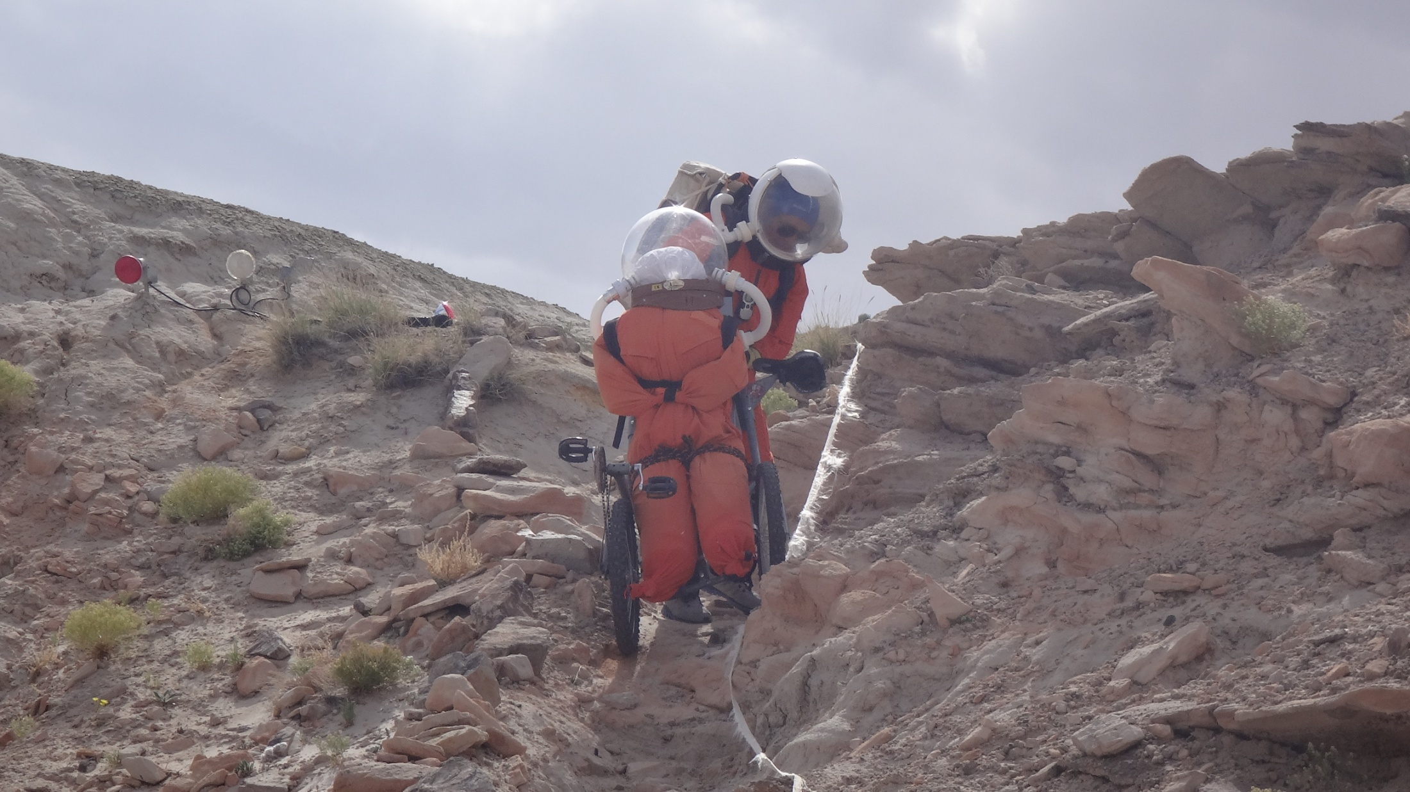
Jorge Mírez in Crew 140 - Crew 141. April 12 - May 10, 2014
Mars Desert Research Station – MDRS, Utah - USA
Bicycle/stretcher “MPC-1”

Slide 7
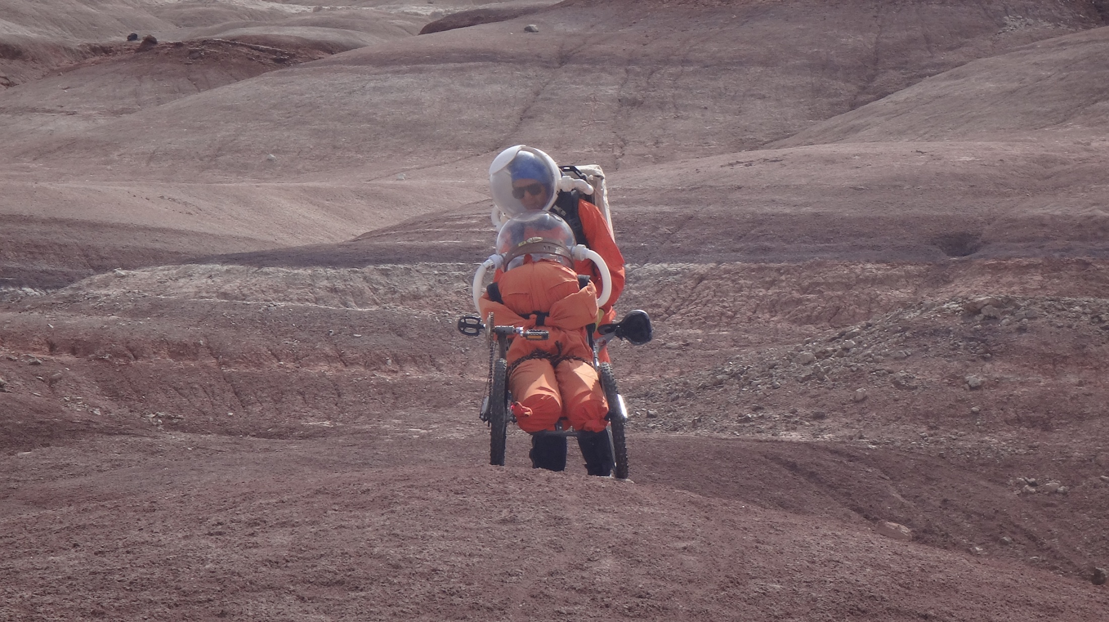
Jorge Mírez in Crew 140 - Crew 141. April 12 - May 10, 2014
Mars Desert Research Station – MDRS, Utah - USA
Bicycle/stretcher “MPC-1”

Slide 8
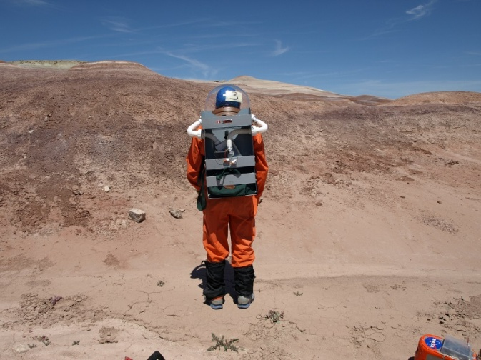
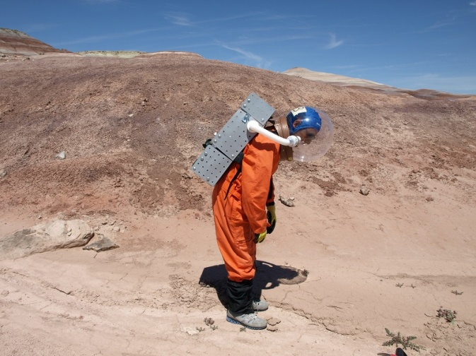
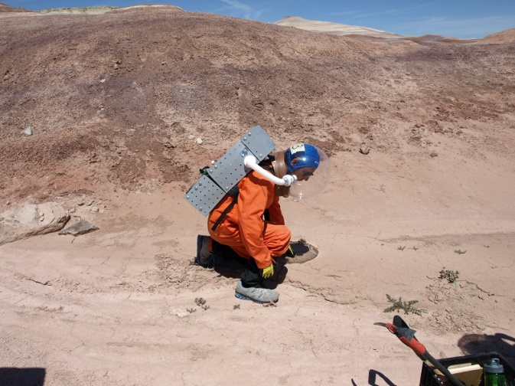
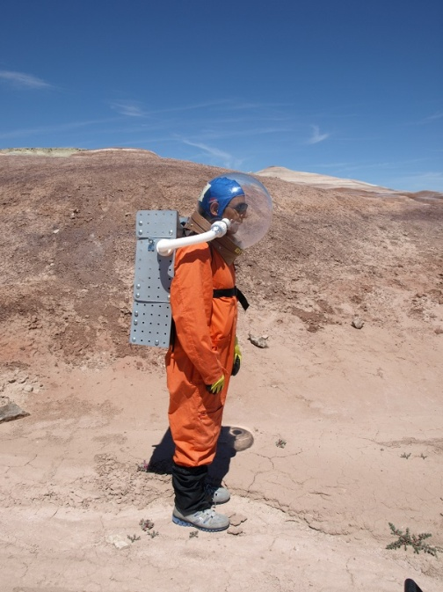
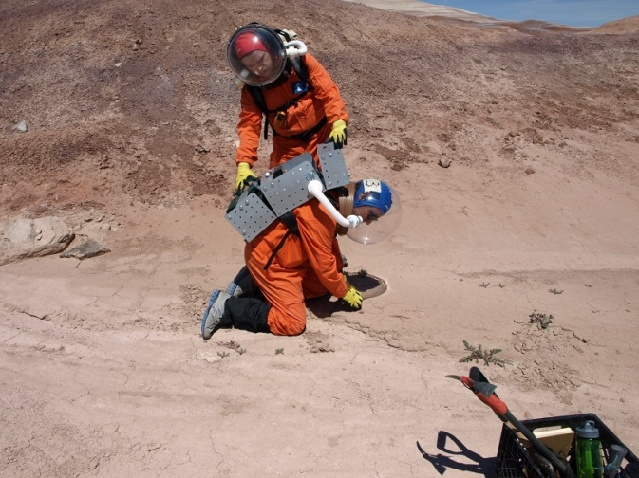
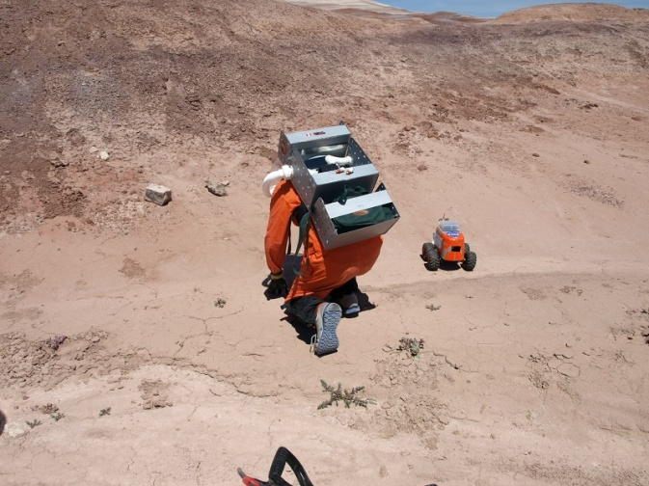
Jorge Mírez in Crew 140 - Crew 141. April 12 - May 10, 2014
Mars Desert Research Station – MDRS, Utah - USA
Backpack “Akunta-1”

Slide 9
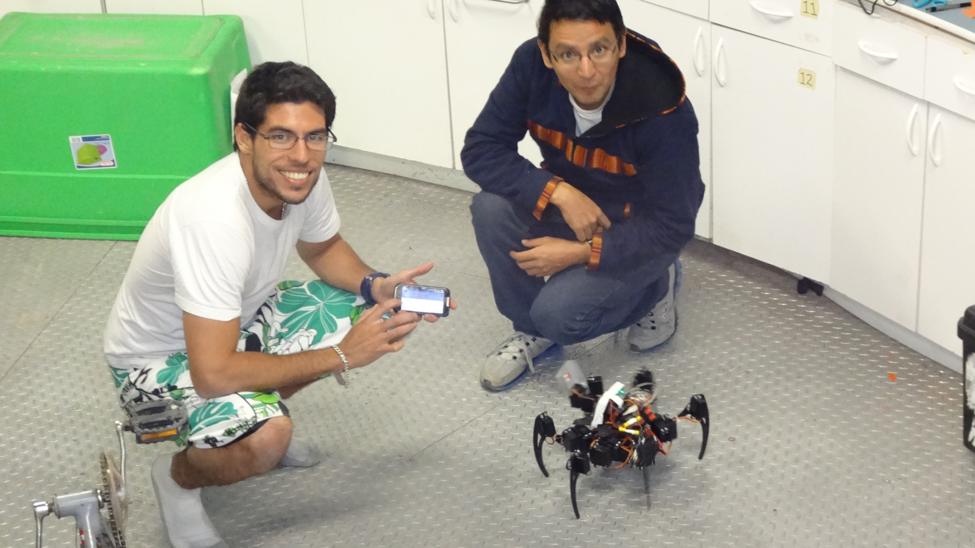
Jorge Mírez in Crew 140 - Crew 141. April 12 - May 10, 2014
Mars Desert Research Station – MDRS, Utah - USA
Rover “Ancasi-1”

Slide 10
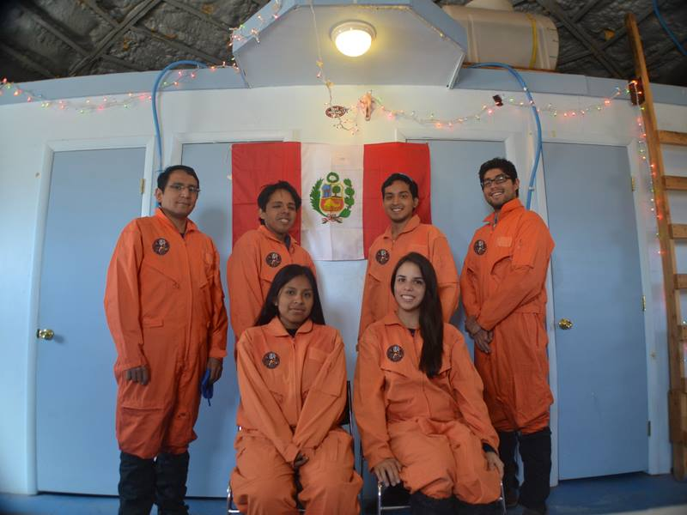
Jorge Mírez in Crew 140 - Crew 141. April 12 - May 10, 2014
Mars Desert Research Station – MDRS, Utah - USA
Crew
140
Jorge Mírez, Adolfo Ubidia, Luiggi Tello, Diego Guillén
Ruth Quispe, Luciana Tenorio

Slide 11
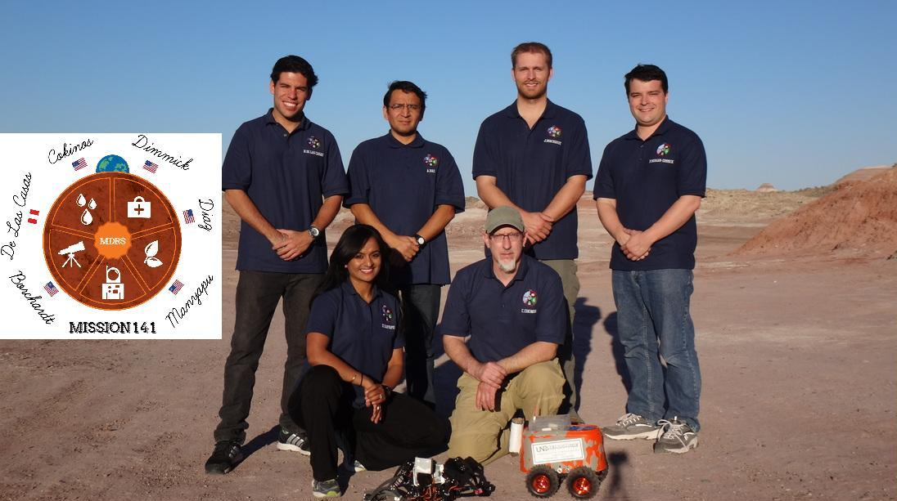
Jorge Mírez in Crew 140 - Crew 141. April 12 - May 10, 2014
Mars Desert Research Station – MDRS, Utah - USA
Humberto de las Casas, Jorge Mírez, Joshua Borchardt , Peter Dimmick
Kavya Manyapu, Prof. Christopher Cokinos
,

Slide 12
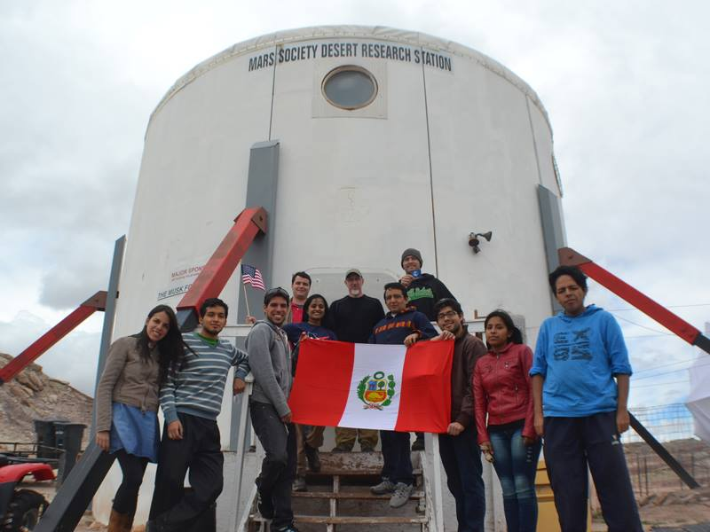
Jorge Mírez in Crew 140 - Crew 141. April 12 - May 10, 2014
Mars Desert Research Station – MDRS, Utah - USA
Crew 140
and
Crew 141

Slide 13
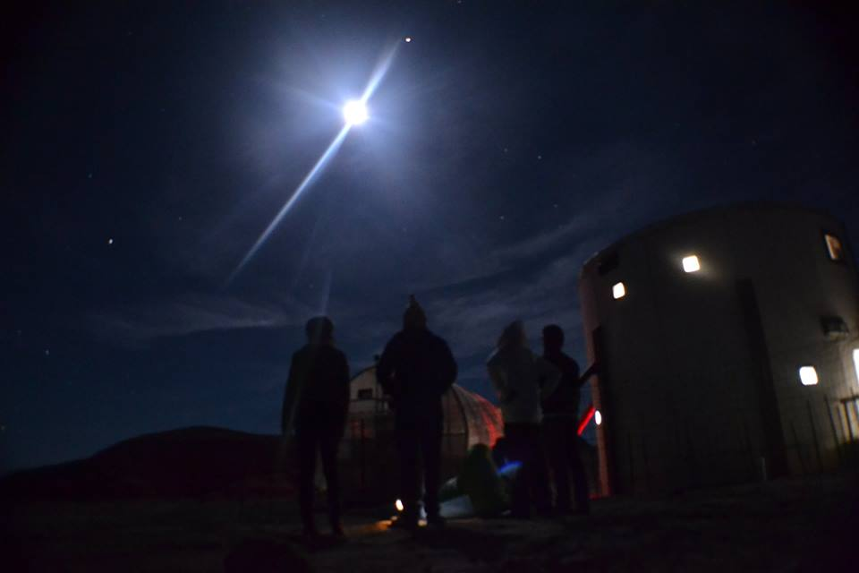
Jorge Mírez in Crew 140 - Crew 141. April 12 - May 10, 2014
Mars Desert Research Station – MDRS, Utah - USA
Lunar eclipse
April 15, 2014
Crew 140
Mars Desert Research Station

Slide 14
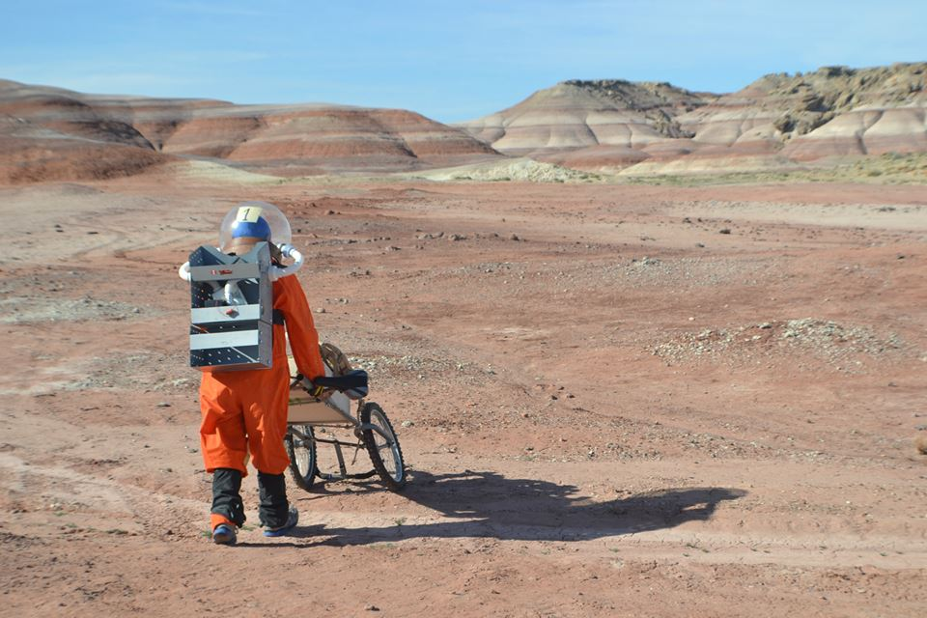
Jorge Mírez in Crew 140 - Crew 141. April 12 - May 10, 2014
Mars Desert Research Station – MDRS, Utah - USA

Slide 15
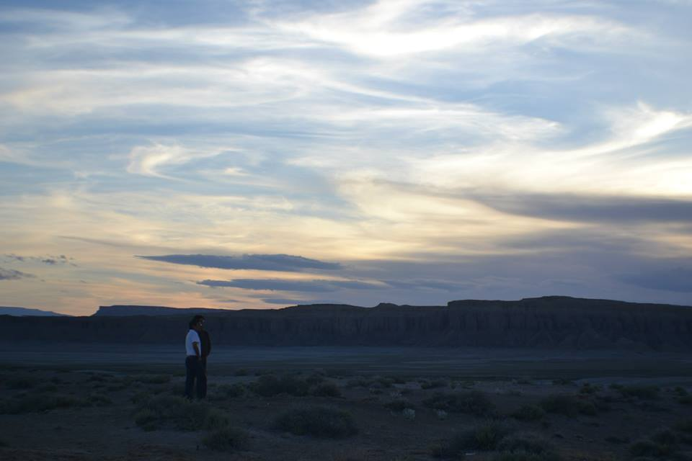
Jorge Mírez in Crew 140 - Crew 141. April 12 - May 10, 2014
Mars Desert Research Station – MDRS, Utah - USA
BackPack “Akunta-1”
Jorge Mírez
Bicycle/Stretcher “MPC-1”
Jorge Mírez
Gerardo Portilla
Teófilo Cortéz
Rover “Ancasi-1”
Jorge Mírez
Terry Ancasi
Humbero de las Casas
Acknowledgment: Dra. Yseki, Fabricaciones Mecánicas -FAMESA, Universidad Nacional Autónoma de Chota - UNACH, Municipalidad Provincial de Chota - MPCH, Hospital Nacional Cayetano Heredia – HNCH, Alejandro Díaz, Kelvin, Luz, Nerio, Gustavo, Teófilo, William and more friends, family, Crew 140, Crew 141 and people.

Slide 16
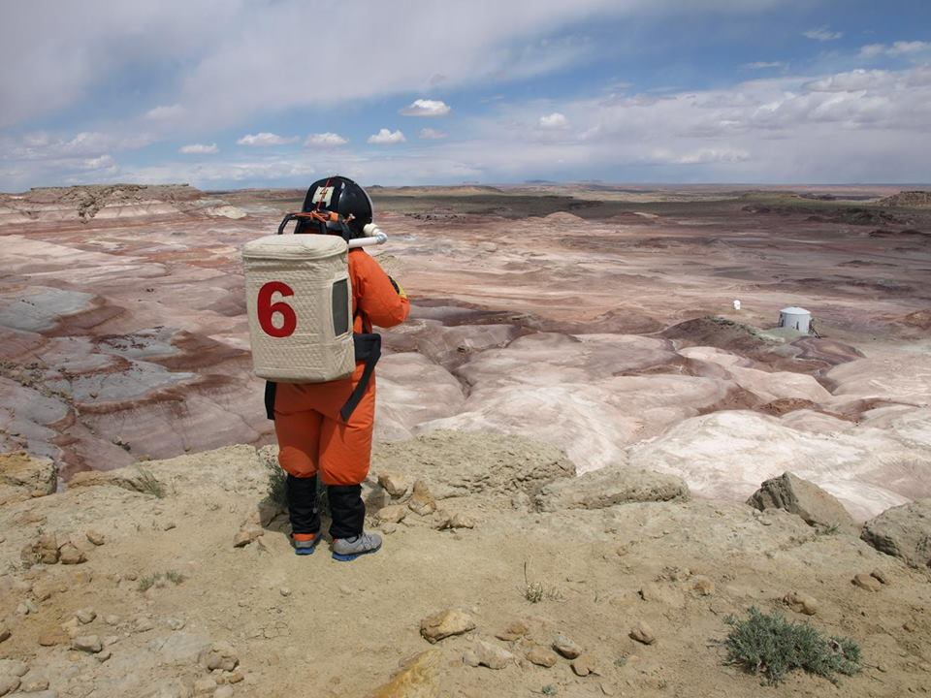
Jorge Mírez in Crew 140 - Crew 141. April 12 - May 10, 2014
Mars Desert Research Station – MDRS, Utah - USA
In total: 28 days of simulation in MDRS…

Slide 17
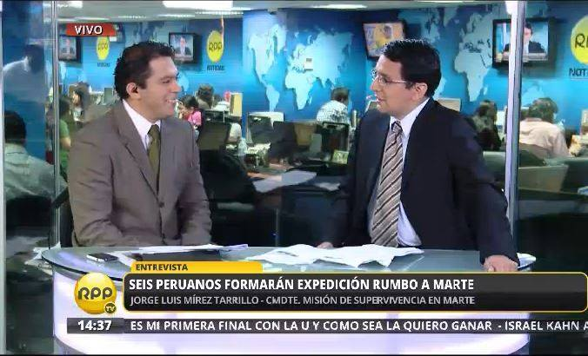
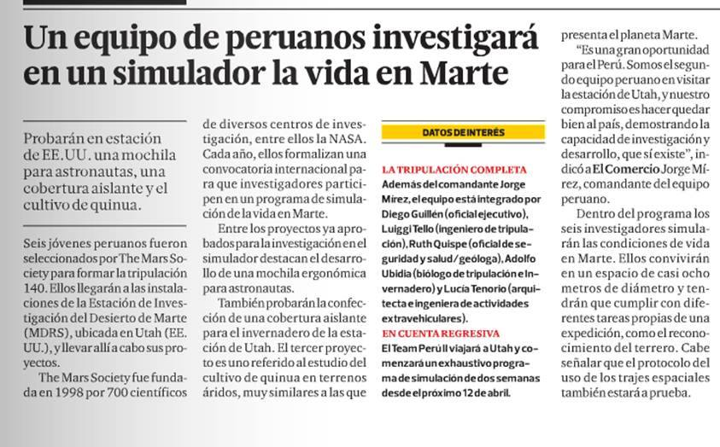
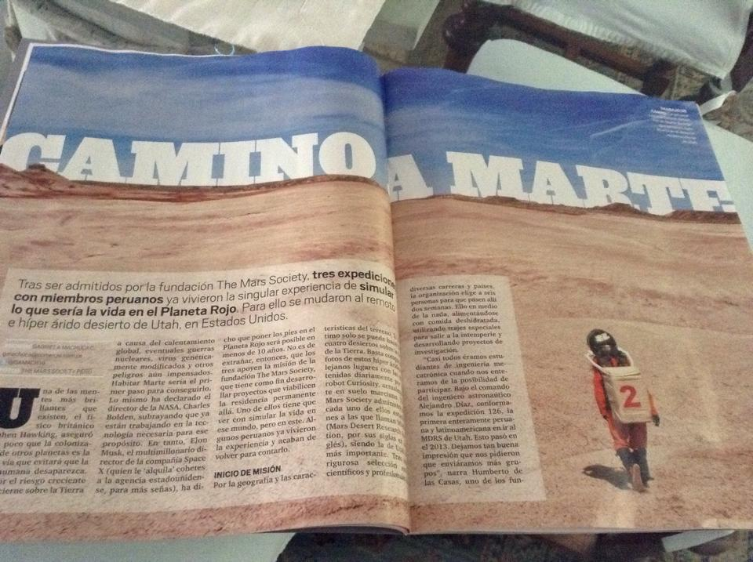
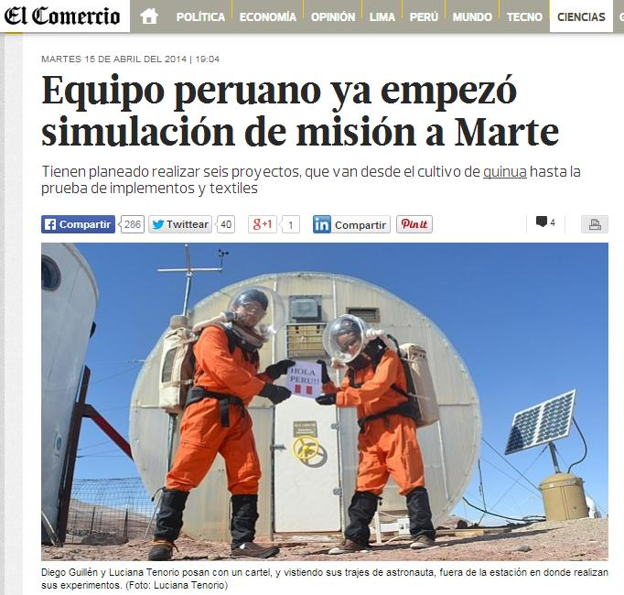
Jorge Mírez in Crew 140 - Crew 141. April 12 - May 10, 2014
Mars Desert Research Station – MDRS, Utah - USA
and more

Slide 18
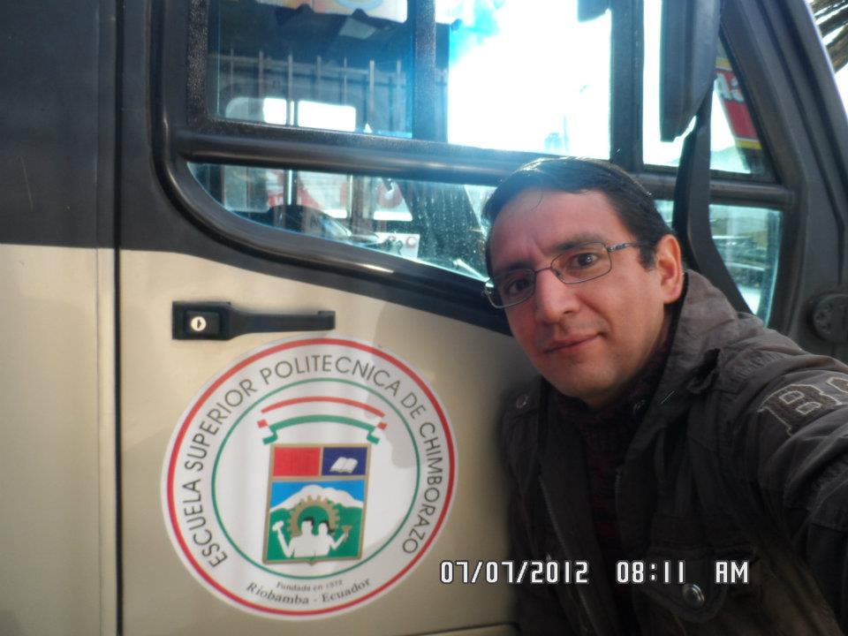
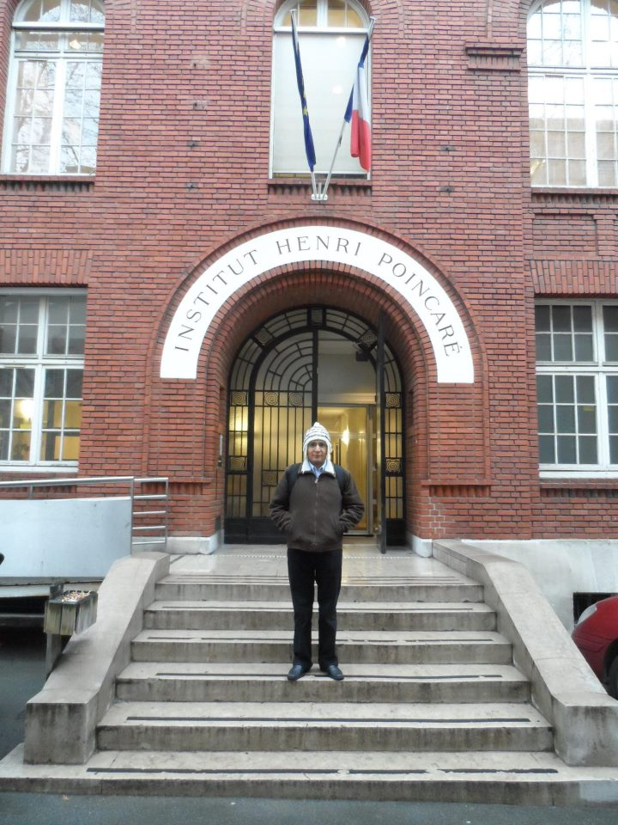
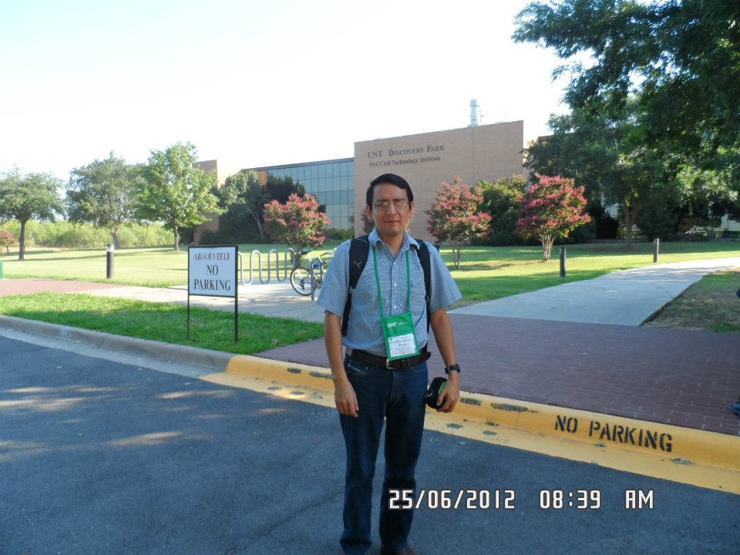
Jorge Mírez in Crew 140 - Crew 141. April 12 - May 10, 2014
Mars Desert Research Station – MDRS, Utah - USA
From 2012: Henri Poncaire Institute (France), North Texas University (USA), ESPOCH (Ecuador)…
Thank you for your support !!
10/01/2013

